Slide 1

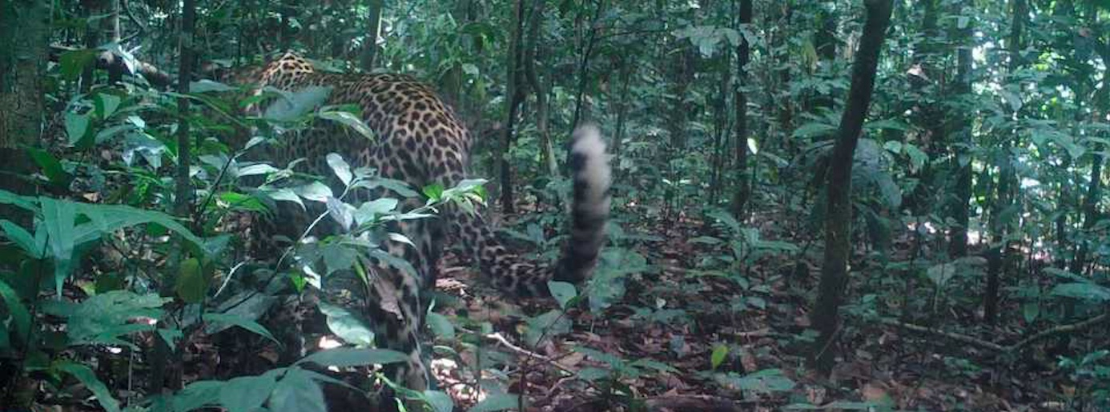
TEAM NO:07
Faculty Name
V.SENTHIL KUMAR AP II/CSE
Christen – 20BCS022
Devasenan – 20BCS025
Jerin Thomas – 20BCS043
Karan – 20BCS048
Kishore – 20BCS057

Slide 2
IMPLEMENTATION FLOW
Actual Flow
Features to be Included
Machine learning Models
Deep learning Models
Front-end
Back-end
Final Out
Prediction for a single image upload
Prediction for multiple image upload
Statistical data about the animals found in the upload
Visualization of the statistical report to the user

Slide 3
ACTION PLAN
Prediction for Single Image
Statistical Report generation
2022
OCT
NOV
NOV
DEC
Prediction for multiple image
Build a website to present the predictions and statistics

Slide 4
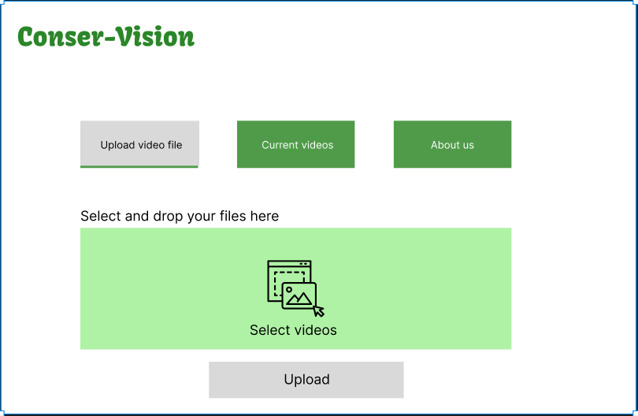
Proposed UI
Functionalities(2)
->Uploading files
->Current files

Slide 5

UPLOAD File Functionality

Slide 6
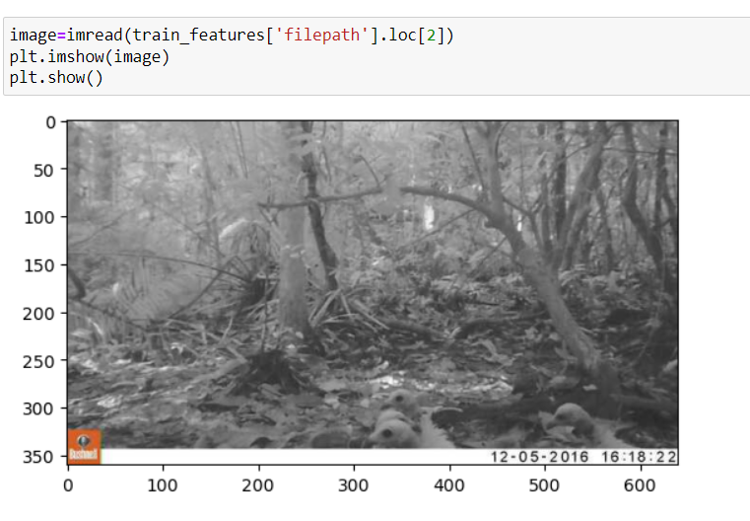
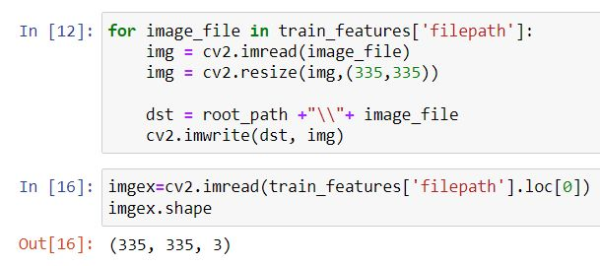
Preprocessing of Data
1. Reading of Image-
2. Resizing of Image-

Slide 7
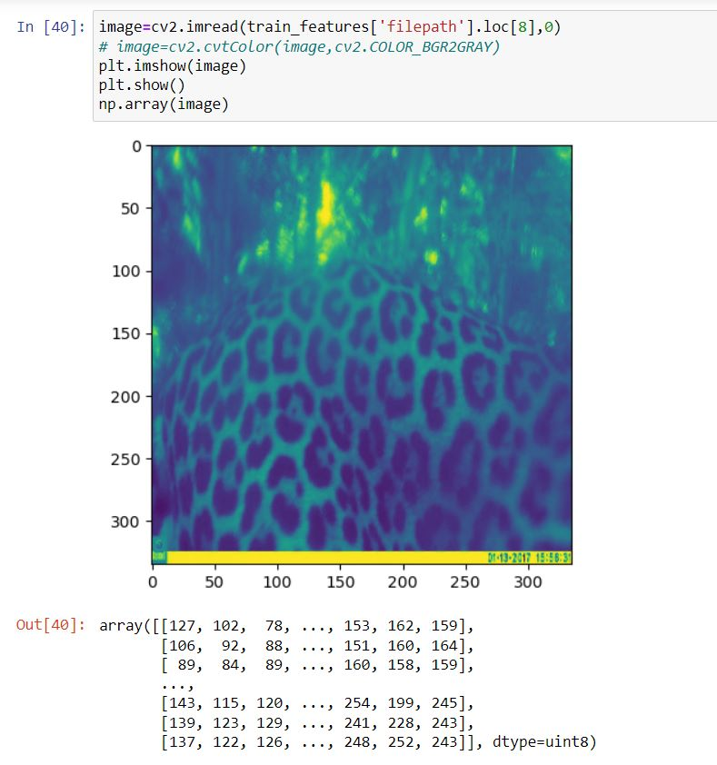
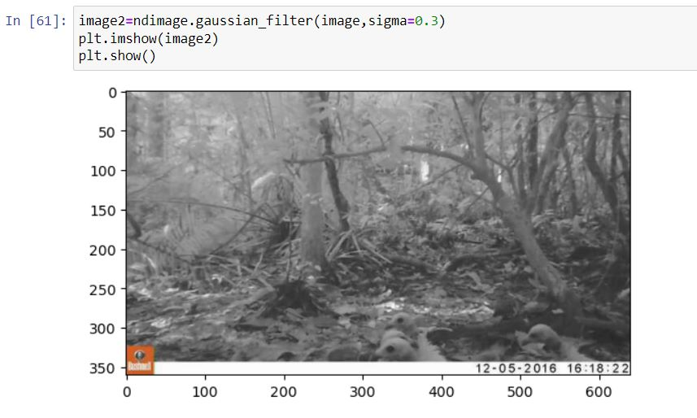
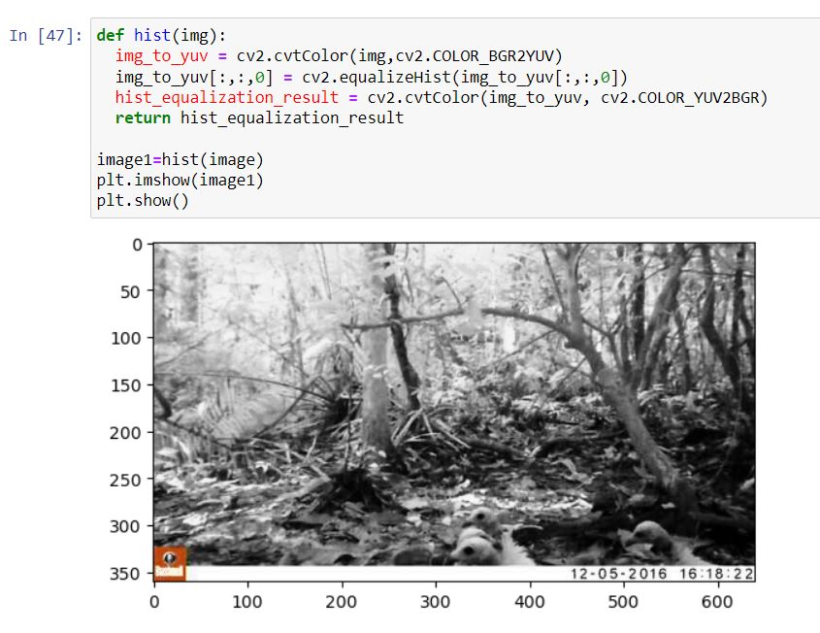
3.Data augmentation
1. Gray Scaling
2. Gaussian Blurring
3. Histogram Equalization
Assign each pixel a value based on how dark it is
Used to reduce noise in the image
Used to increase Global Contrast of the image

Slide 8
SOLUTION
Our Goal
TARGET AUDIENCE
Our goal is to classify the species that appear in camera trap images collected by our research partners at the Wild Chimpanzee Foundation and the Max Planck Institute for Evolutionary Anthropology.
Zoos and Wildlife reserves
COST SAVINGS
EASY TO USE
Manpower is saved as not that many people is needed to track the animals which in turn will save cost.
Simple design that gives user's the targeted information they need

Slide 9
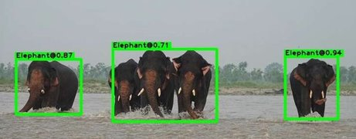
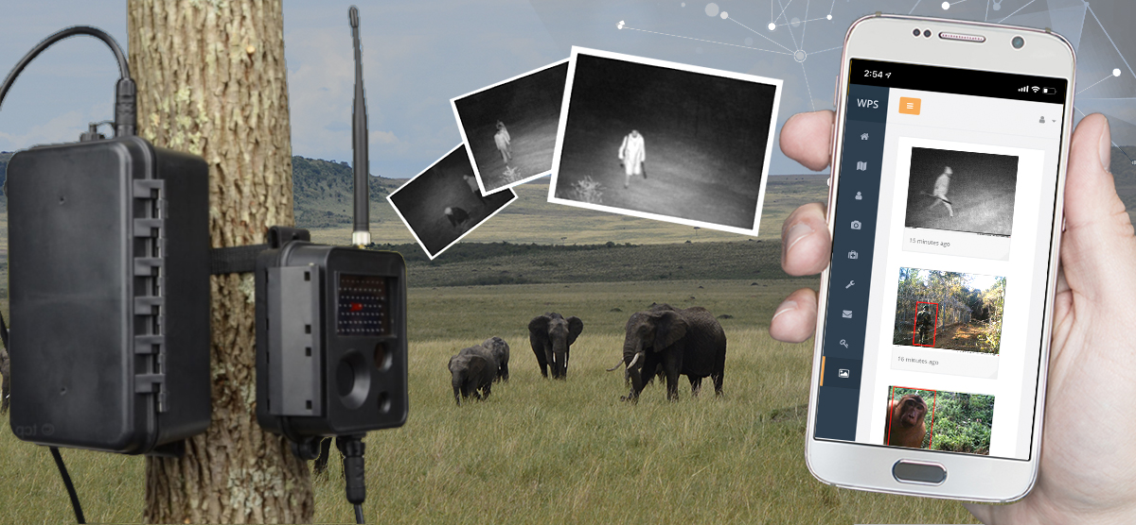
SUMMARY
This Project is all about exploring different kinds of animal and to identify them based on their species. Automatically identifying, counting, and describing wild animals in camera-trap images with deep learning

Slide 10
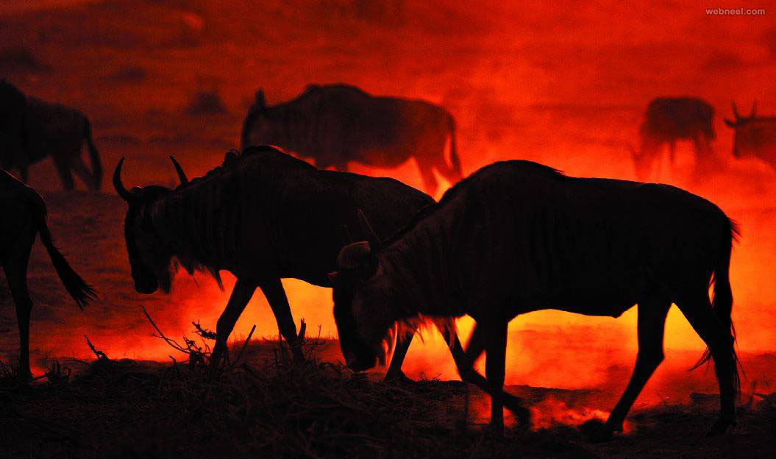
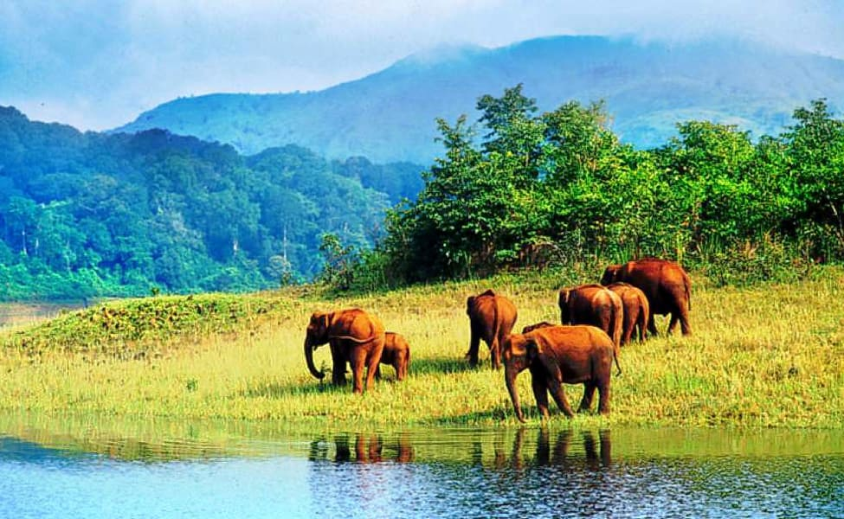
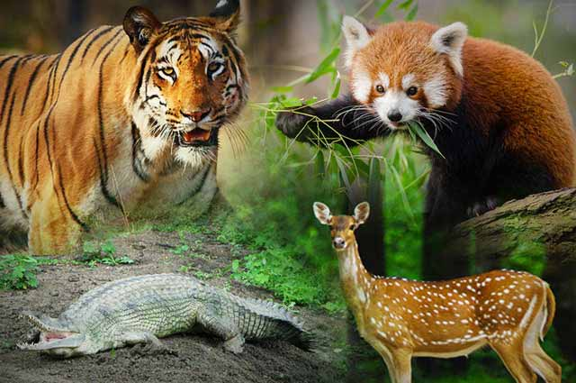
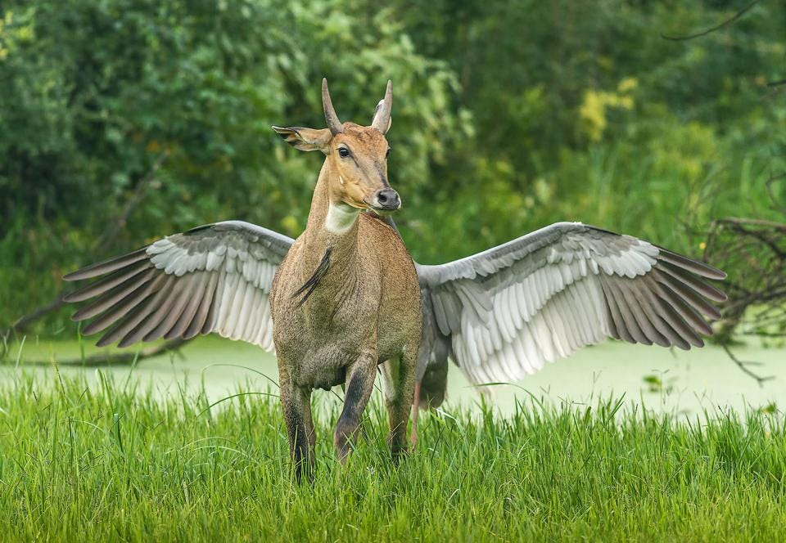
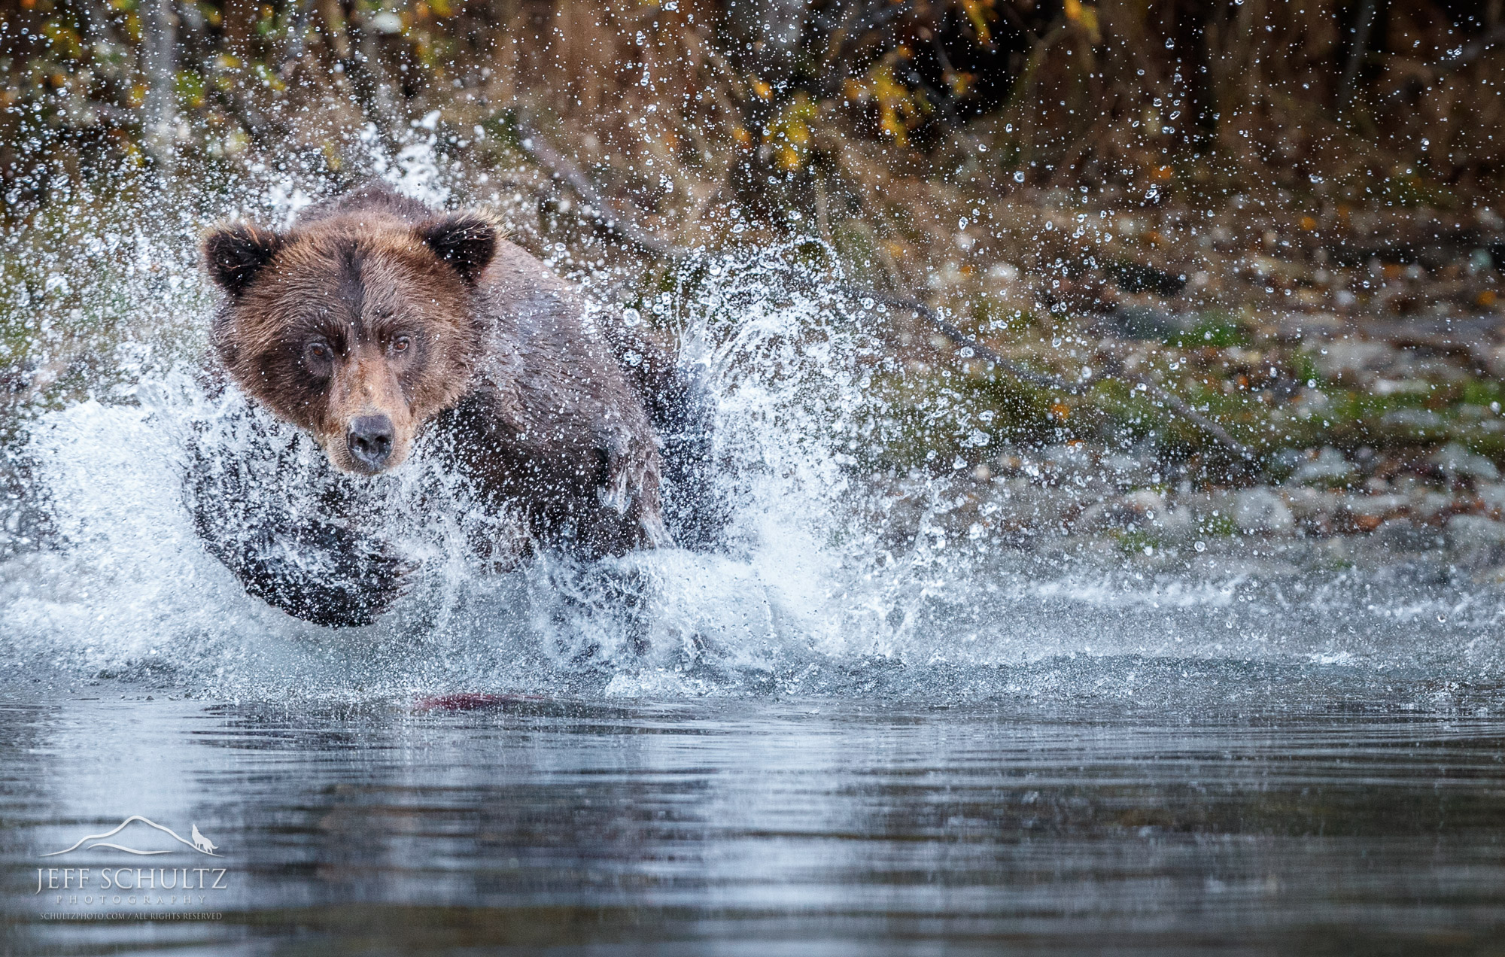
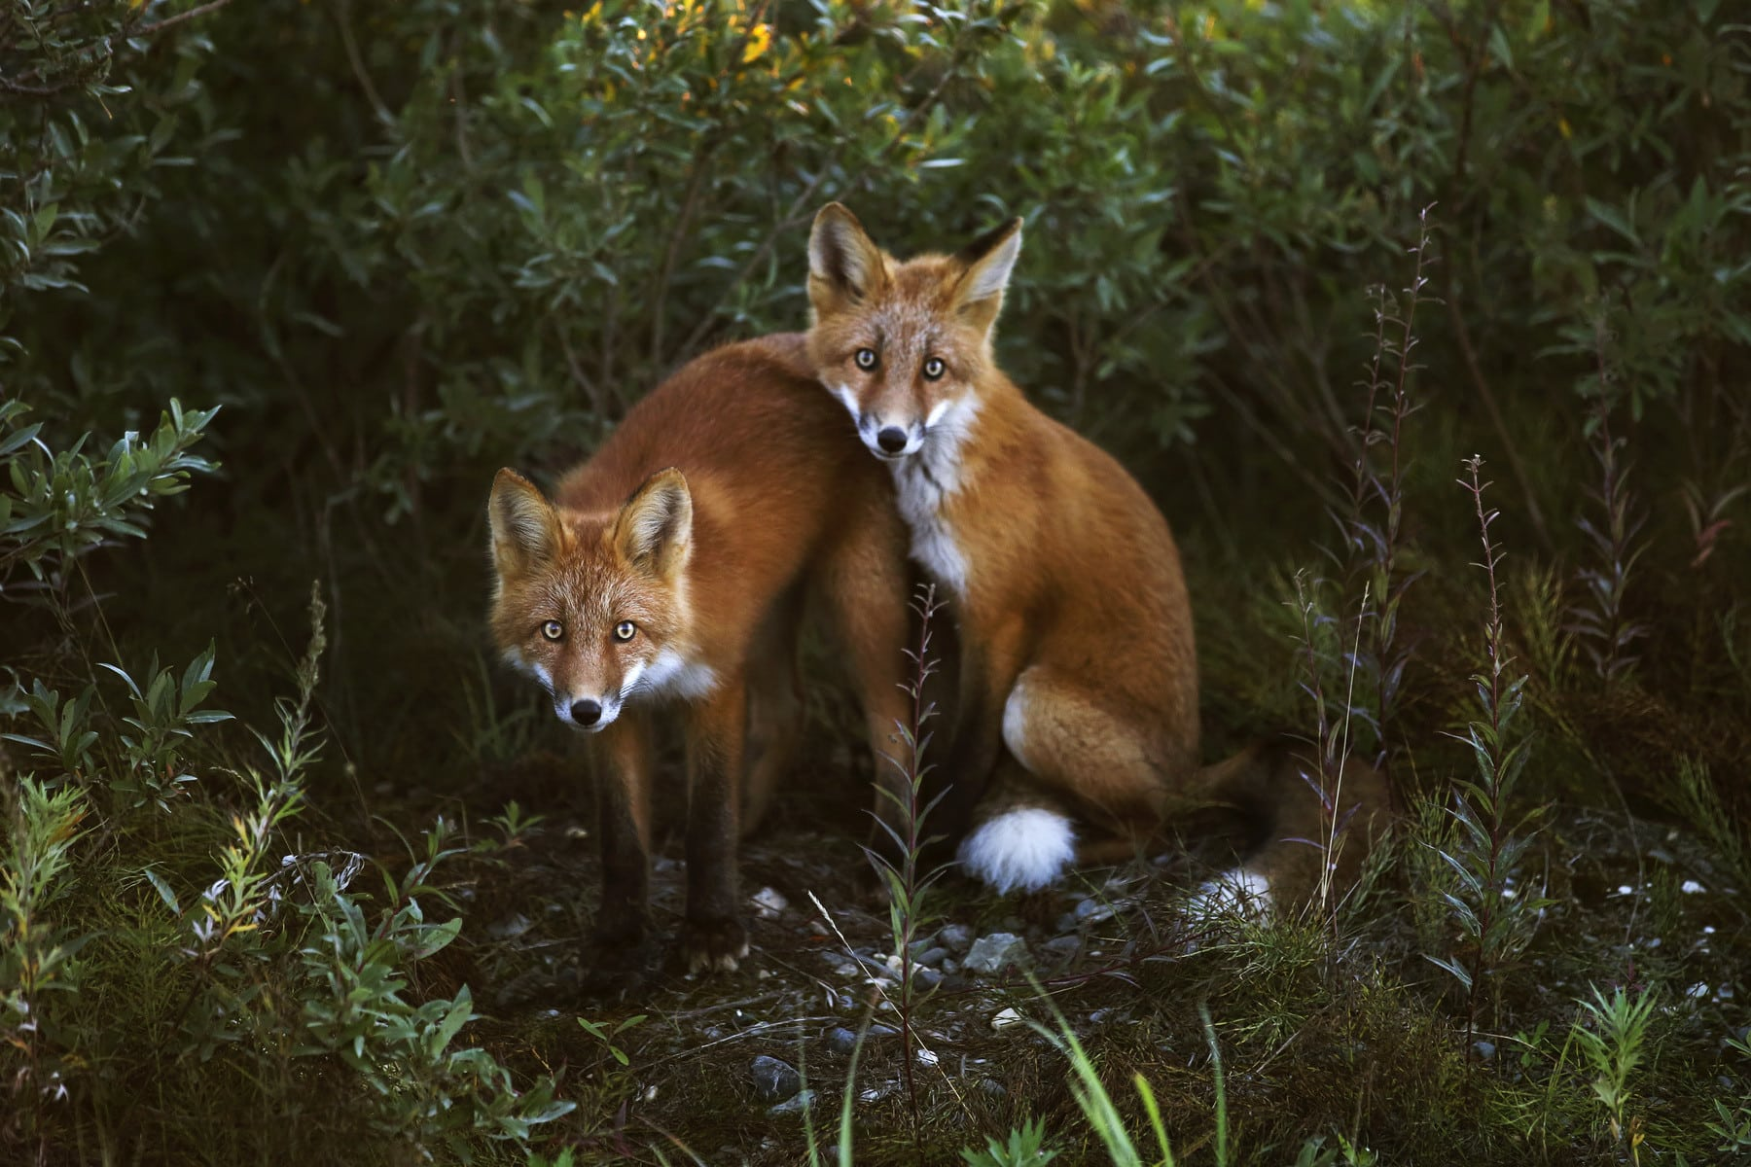
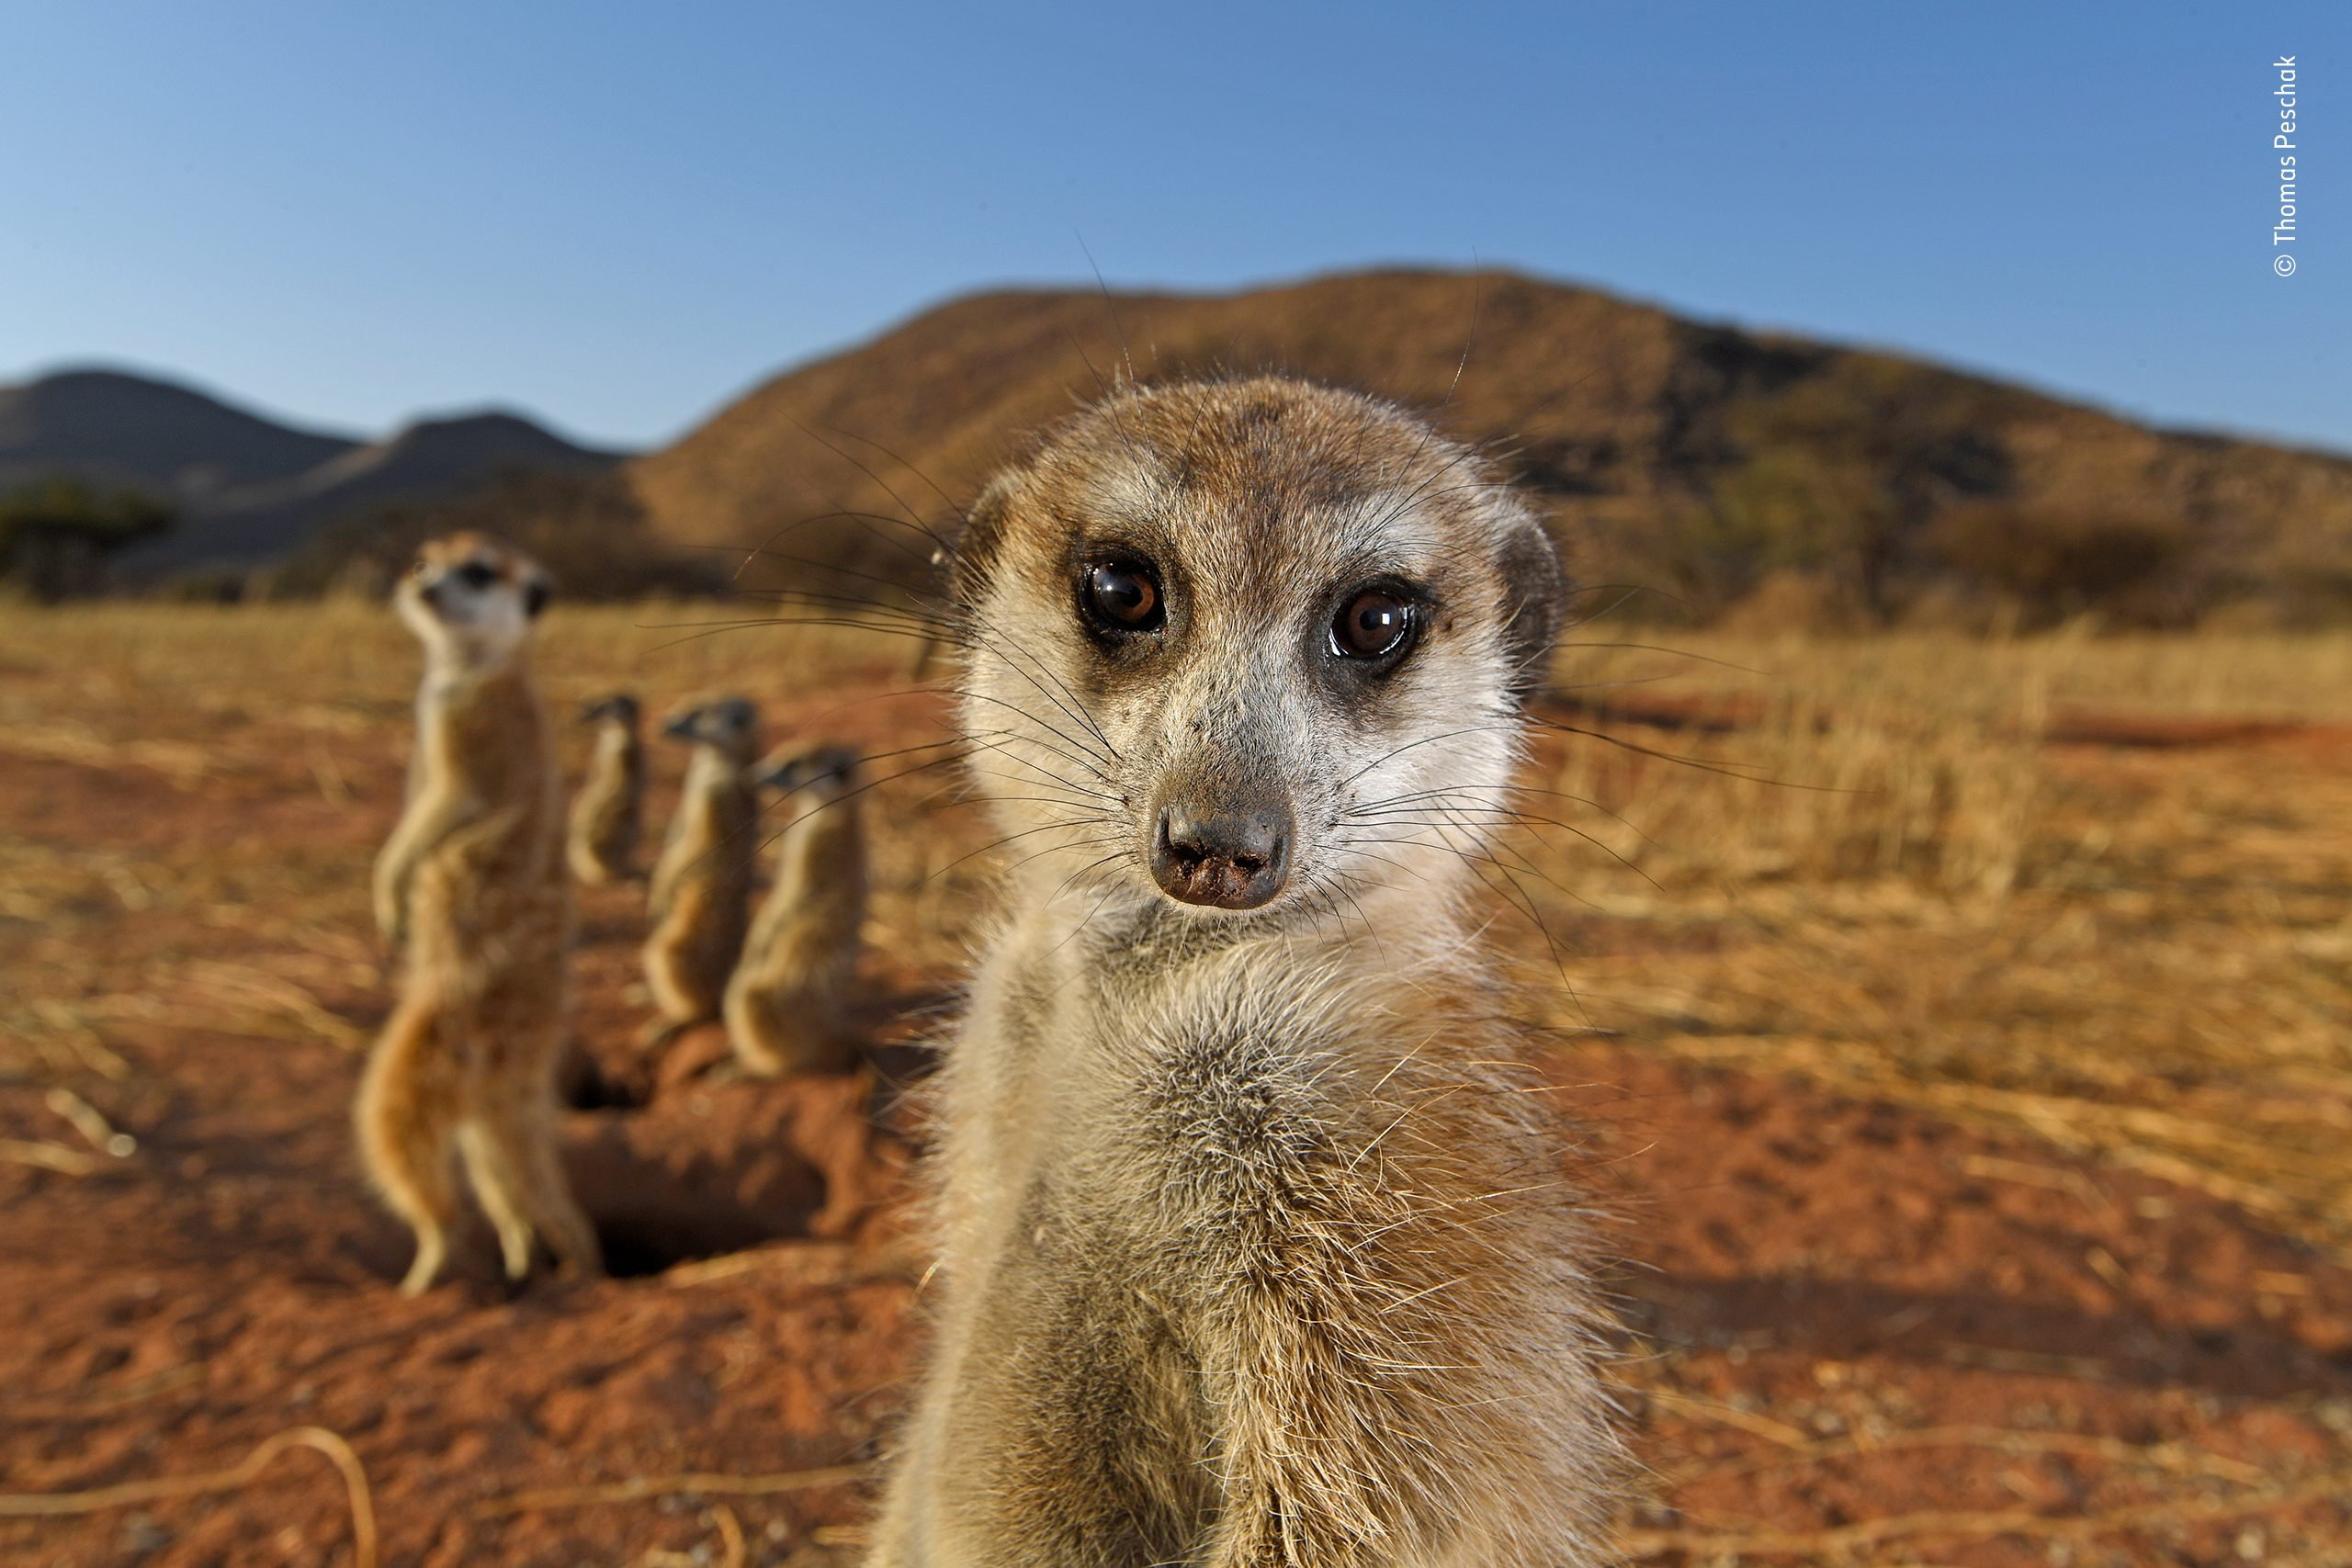
THANK YOU

